Slide 2
The Process:
To prepare for our life changing project, the first preparation step we took was we set ourselves some goals, which include preventing and solving the following problems: pollution, littering, climate change, and disposable plastic usage. And yet this is just the beginning, but by time our ideas evolve and become more effective and help the environment more and more. To prepare we also identified the problems and created a project schedule to help organize our time for this project. We first thought of this project when we had seen an online poster explaining the environmental problems and how we should take care of the world we live on. This inspired me and my team, and we planned the E.C.O. As soon we made our team and were all inspired by this idea, we started planning. We first looked at the basic problems, like littering and pollution and solutions, and went into more complex things like climate change and tree cutting, also discussing how to solve these issues.

Slide 3
Exploring the project:
Going in depth to the project, we must know the impacts and aspects of our projects which is why we have created a flowchart to determine aspects and impacts, according to their significance:
First thing that we need to think about when looking at the impacts and aspects of our projects is identifying the idea or activity. For example, let's use this flow chart to find the impact of the gardening group that we have put into action. The process will be planting and gardening. The next arrow in the flow chart can be determines the environmental aspects, or process flow chart. Let's stick to does this activity determine environmental aspects. Well, yes of course, plants greatly determine environmental aspects as they release oxygen and don’t have harmful air emissions, effluent discharges, waste arisings, or no land contamination obviously as they are plants.

Slide 4
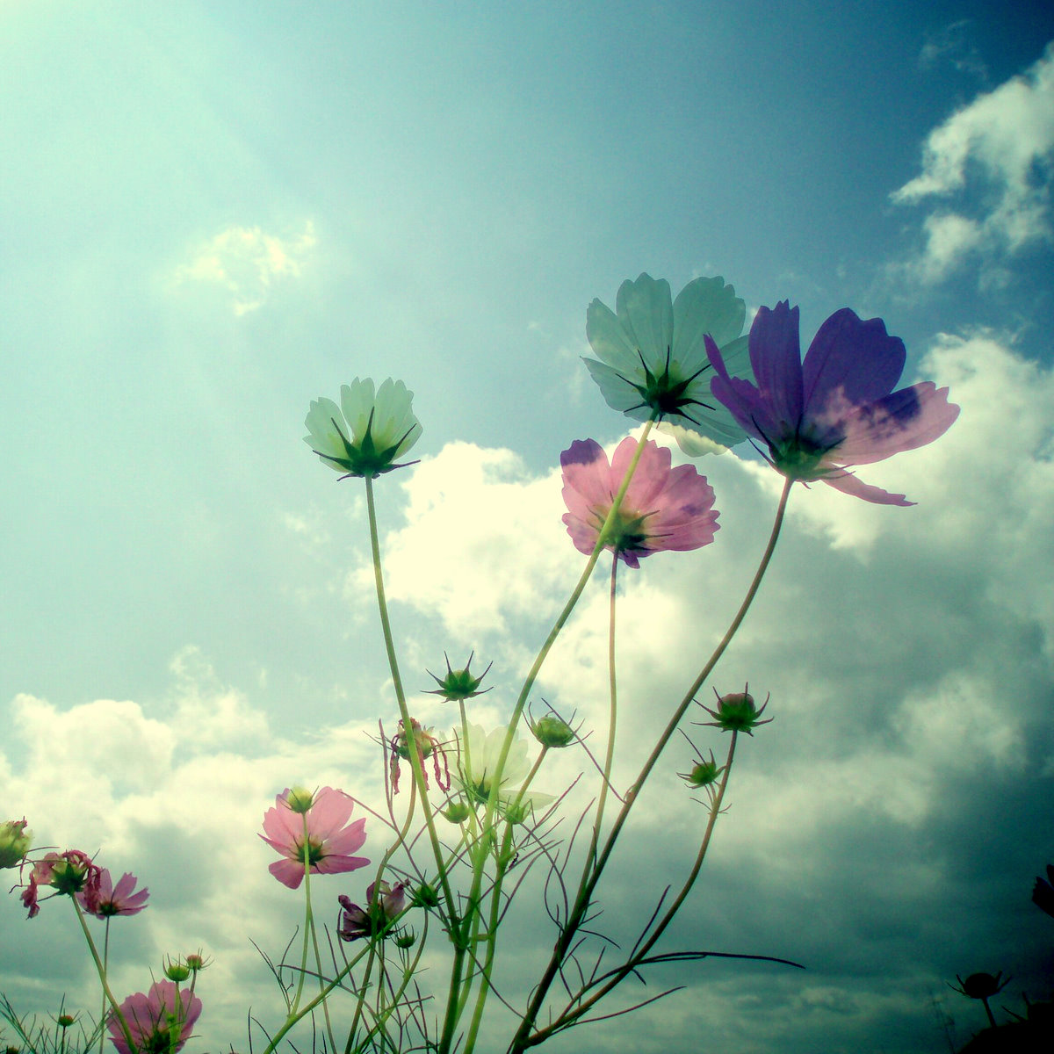
Exploring the project continued:
The next step is that does this determine the environmental impact? Yes, in this case planting does as plants and trees provide a multitude of benefits, both long and short term. As well as being attractive aesthetically, they remove and store carbon from the atmosphere, slow heavy rain and so reduce the risk of flooding, enhance air quality and improve the urban heat island effect by reflecting sunlight and providing shade. The next step on the flowchart is that we need to analyze and grade the significance of this activity, and in this case, we can say it is very significant as the past boxes in the flow chart were very positive. Therefore, in this case I grade the significance as ten out of ten. Nearly there, only a few to go with the next step being environmental risk analysis. After thorough research, I have concluded that plants themselves are very helpful and beneficial to the environment and have a zero-risk level of harming the environment. The next and final step in this way of the flowchart is the objectives and targets. Well, plants have many objectives, as well as the planters too. We need plants to breath, to eat, to reduce air emissions and global warming, and for the biomass and many more. The objective and aim of the gardener are to maintain the beauty of plants, outdoor grounds, and trees in a garden. They perform a range of general maintenance tasks including designing, producing, renewing and preserving outside spaces. They also need to make sure the plants are being grown in an appropriate way. Now that we have finished following the flowchart, we can now decide in one of our meetings if this club and activity is necessary, which is and assured yes.

Slide 5
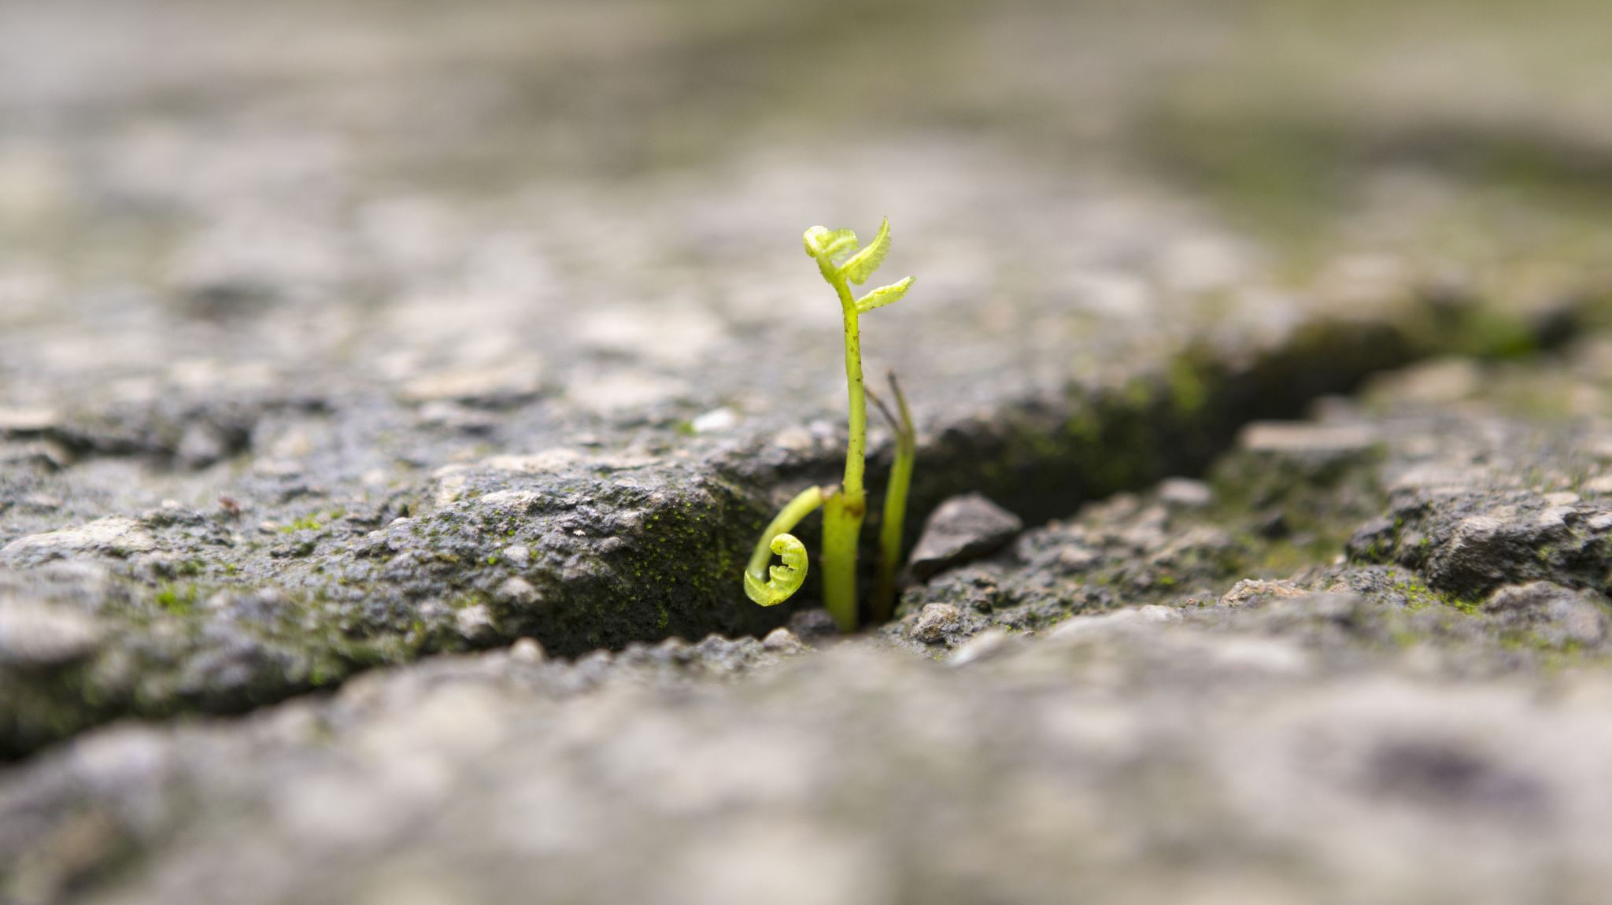
the stages:
Now that we have our base of our organization, it's time to set a goal and become more organized. In this case, our goal is clear; we aim to solve all problems that affect the environment including climate change, pollution, unrecyclable plastic usage, global warming, food waste, increase of garbage instead of recycling, and so on. As our organization is still new and recent to opening, we need to be organized as much as possible. The solution?; simple, you create a schedule! Recently when everything became stable in planning, we created a schedule of when meetings occur, when the different clubs we have begging and finish, and when our discussions to improve out remarkable ideas, which happens most of the time daily.
Finally, the last and most important stage, is put the organization into action, the implementation. We have brought our zoom meeting and planting groups into action, however; due to the pandemic that has affected everyone worldwide, we make sure not to spread the virus and therefore cannot leave our houses. Unfortunately, now everything is online, and we cannot carry on outside and large group physical activities, many of our clubs are now limited.
To complete this superior idea and organization, we had to take many steps and stages, from starting of small as just being inspired, onto getting bigger, creating a schedule, having an environment caring and interested team, activating activities and careful stable planning, to ensure the organization goes as plan. To explain in detail, the first step we took after each one of us have gotten interested in this project, we set the team up. We made up the team of many interested and determined young people and opened many clubs in this organization, like the gardening and discussion clubs, and yet many more. After we have got a stable team, we chose a leader, which we all agreed on for the characteristics of open-minded, creative and have leadership skills and perfect communication, which we all thought was key for the leader to be.

Slide 6
The Results And Outcomes:
OVERALL, the results we expect from the organization IS TO MAKE THE ENVIRONMENT A HEALTHY GREEN PLACE TO BE IN AND ENCOURAGE PEOPLE TO GET INVOLVED. WE HOPE THE RESULTS WILL BE A BIG DIFFERENCE, WHERE THE WORLD WILL CHANGE TO THE BEST, WITH NEW ENVIRONMENT HEALTHY ROBOTS, LESS USE OF CARS, LESS POLLUTION, USE OF RENEWABLE ENERGY, DECREASE CLIMATE CHANGE, CLEAN streets, AND PLANTS BEING PLANTED. WE ARE ALL VERY KEEN TO SEE THIS PROJECT AT WORK AND SEE THE WORLD CHANGE.
Although these were quite a lot of simple ideas, we had given you, this is just the beginning, and we plan to look at the problems that affect the environment, that many may not take in mind. An example of this is agriculture, which yes is an environmental problem.

Slide 7
QUIZ:
We have added this short quiz to see how much you know about our project and about the environment. Have fun!
NOTE: to play the quiz, please play as a slideshow.
START QUIZ!

Slide 8
Question 1: What is the main aim of our project?
A. To solve all problems affecting the environment.
B. To sit down and watch others do all the hard work, and not helping.
C. To only focus on one problem, like climate change and don’t focus on anything else.

Slide 9
CORRECT!
WELL DONE!
"A" was the correct answer.
-Next question-

Slide 10
WRONG!
OOPS!
That was the incorrect answer.
-Try Again!

Slide 11
Question 2: which of the following is safest to use in terms of environmental care?
A. Use energy like nonrenewable energy that create greenhouse gases.​​​
B. Renewable energy, like wind energy or biomass.​​​
C. Don’t use energy at all to not make greenhouse gases, or to not waste energy, and rely on your own survival skills.​

Slide 12
CORRECT!
WELL DONE!
"B" was the correct answer.
-Next question-

Slide 13
WRONG!
OOPS!
That was the incorrect answer.
-Try Again!

Slide 14
Question 3: What inspired our organization to be what it is now?
A. we were bored and had nothing else to do.
B. we were told to make an environment idea, so we made it just for the sake of it.
C. one of the group members saw an online poster that inspired us to help the environment, and then we created a team.

Slide 15
CORRECT!
WELL DONE!
“C" was the correct answer.
END OF QUIZ!

Slide 16
WRONG!
OOPS!
That was the incorrect answer.
-Try Again!

Slide 17
END OF QUIZ
Great, you finished the quiz.

Slide 18
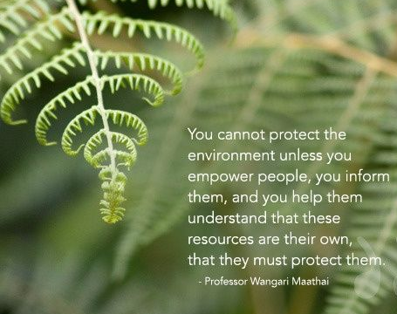
END OF PRESENTAION!
Phew, that was a lot of reading, but look! You’ve made it to the end. My team and I hope you enjoyed this presentation. Maybe you’ve even learnt something new and are going to implement it in your daily life. Thank you for watching till the end!

