Slide 1
The Conferencing Case
By: Amrah Usmanmia, Maryam Mohammed, Aminah Khan

Slide 2
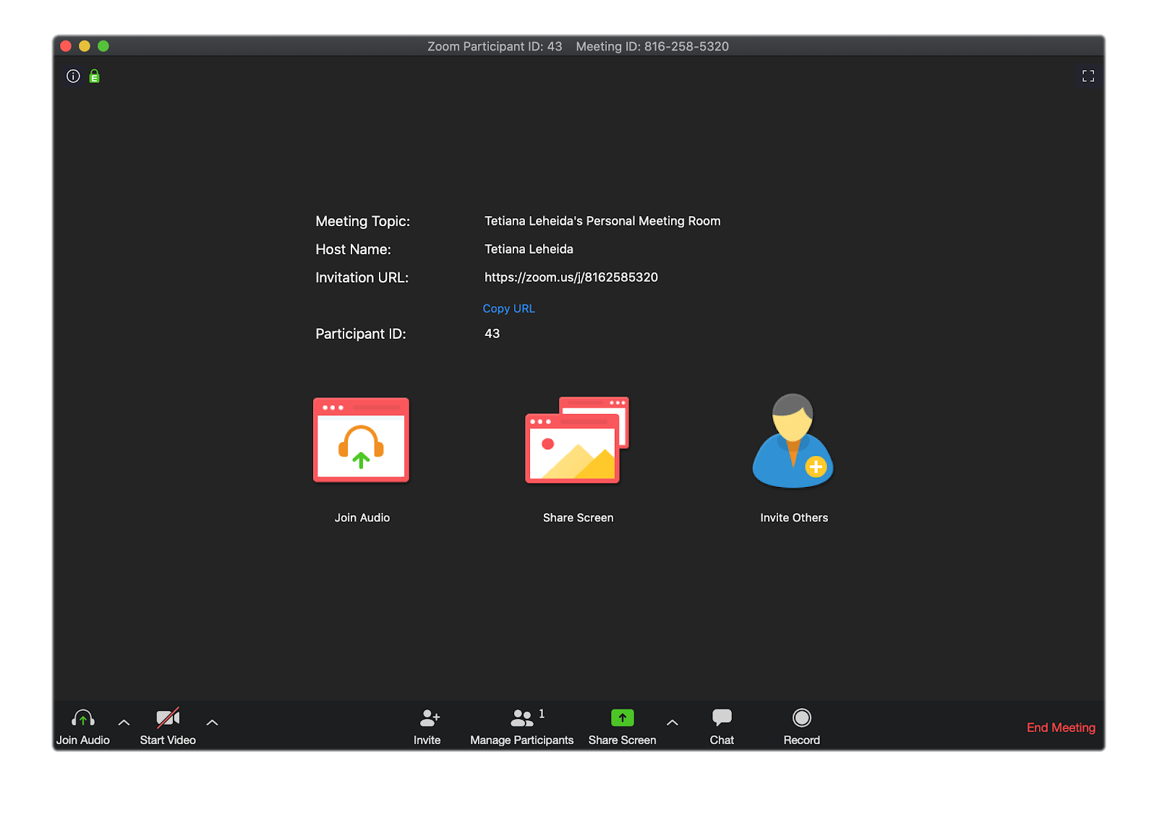
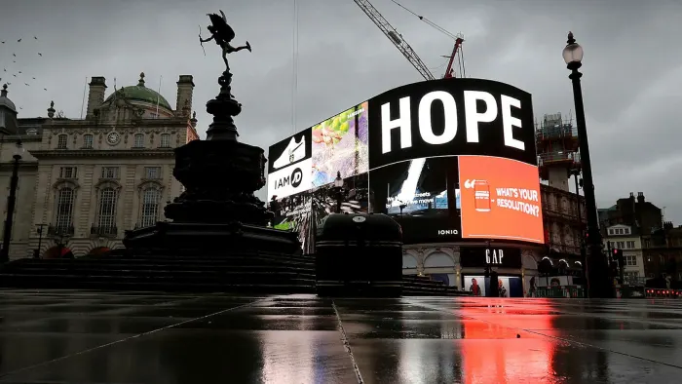
Inspiration
The situation of the current world
Increase in the number of video calls from 10 million to 300 million
The need for appropriate technology

Slide 3
Stages of development
1
2
3
We knew we wanted to take inspiration from the current events happening around the world. We wondered what we could do to help the millions of people stuck at home due to the pandemic
At first we wanted to create a case that would facilitate hygiene products that have become essential in our everyday lives. For example, masks
We realised that due to the safety regulations of the pandemic, countless things have gone online
As a result, people are now online more than ever and the use of technology has become prevalent in most houses.
One thing people are doing now, more than ever, are making video calls; be it for work or for family
So what would be better than creating a ‘Conferencing Case’?
4
5
6

Slide 4
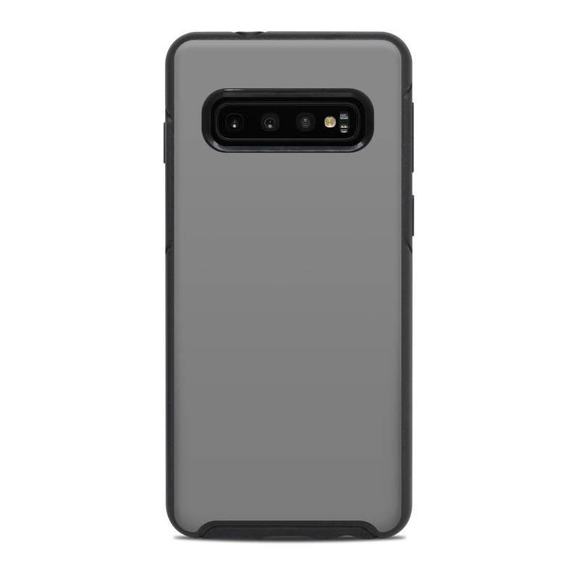
Design
In this case, we have incorporated all the necessary features to ensure the best video conference

Slide 5
Outcome
We present you with…
The Conferencing Case

Slide 6
Lighting modes
Cool-white
Warm-white
Neutral

Slide 7
Light switch
1.Press this button to change the colour of the LED lights
Hold down this button for 5 seconds to turn the lights off
1

Slide 8
Case and phone charging point
1. USB C charging port-for the lights
2. Headphone jack
Back
2
Bottom
1

Slide 9
Retractable camera
1
2
3
1. To activate the camera hold down the button
2. This will activate the front facing camera
3. For the back-facing camera; manually twist it around

Slide 10
Retractable tripod
Retracted and folded away
Extended and unfolded

Slide 11
Sound Amplification
1. Amplified sound
2. Takes the sound from it’s original output and amplifies it out the side of the case
Case without the phone
2
1

Slide 12
Final product
Front
Back

