Slide 1
Wonderous

Slide 2
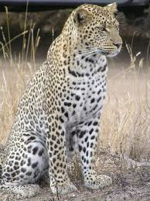
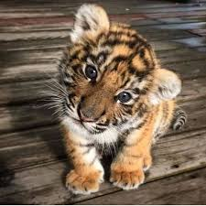
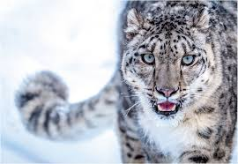
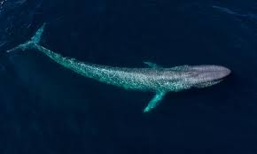
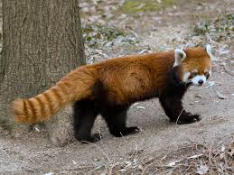
Our main aim is to make an awareness on endangered animal. As these days people aren’t aware of the what happens in the animal kingdom and how animals wake up fearing their lives. So by making this phone case, a quarter of that profit will go to helping endangered species around the world.

Slide 4
How our customers will receive their phones
Our costumers will pick their own endangered animals they want on their phone case.
Then they will send us their picture through our E-Mail @wonderous.Gmail.com
After they send it to us we will print their desired picture and attach it to the coloured phone case of their desire.
Then we ship our product to our costumers and a quarter of the money will go to an animal charity raising money for endangered animals.

Slide 5
How our phone will look
Our phones will have our costumers chosen endangered animal and will have their own name personalised onto it.
Our costumers will be in total control through our website.
www.Wonerouscases.com
Here they will be able to customize their phone with colours and their pictures.

Slide 6
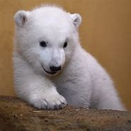
More of our designs:

Slide 7
Creators:
Faatimah.Lakotta
Maryam Hussain
Fatimah. Ahmed
Hajra. Hasan Ali
Tayyibah Ashraf

