Slide 1
Doctor
NHS competition: Done by Sabah Sayed in Year 9.

Slide 2
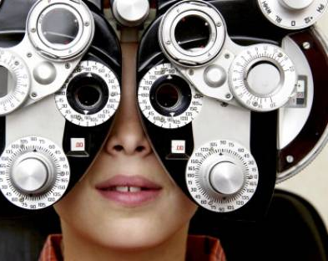
What is an ophthalmologist doctor? And Why is it an important role in the NHs field? Ophthalmologist doctors are eye specialist. They handle all the medical aspects of eye care. They do surgeries and other treatments. We need these types of doctors because many people have eye problems in the world, and it is very important that we have good eye specialist who can do treatment for people.

Slide 3
What degree do you need to become an ophthalmologist doctor?
Ophthalmologists need a Medical degree, which requires students to first earn a Bachelor’s degree. Common majors include Biology and Chemistry before enrolling in medical school
Before you train as an ophthalmologist you must complete a degree in medicine and have obtained a MBBS or equivalent qualification.

Slide 4
GRADES AND SUBJECTS THAT NEED TO BE TAKEN IN ORDER TO BECOME A OPTHAMPOLOGIST.
Five GCSEs (A-C), including English, maths and science
Three A levels (with at least two in science-based subjects)
Essential qualifications
BSc (Hons) degree in optometry

Slide 5
Related skills
Administration
Attention to detail
Communication
Discipline
Interpersonal skills
Organization

Slide 6
WHY IS IT A GOOD JOB?
It’s a good job because you get to give yourself an opportunity to serve other people.
And by taking care of other people you get so much reward.
You are treating other people and making sure they get better.

Slide 7
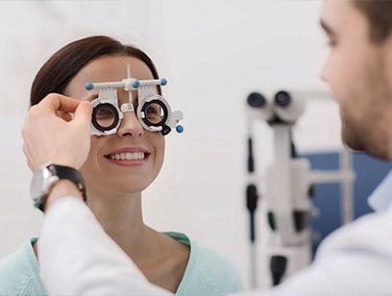
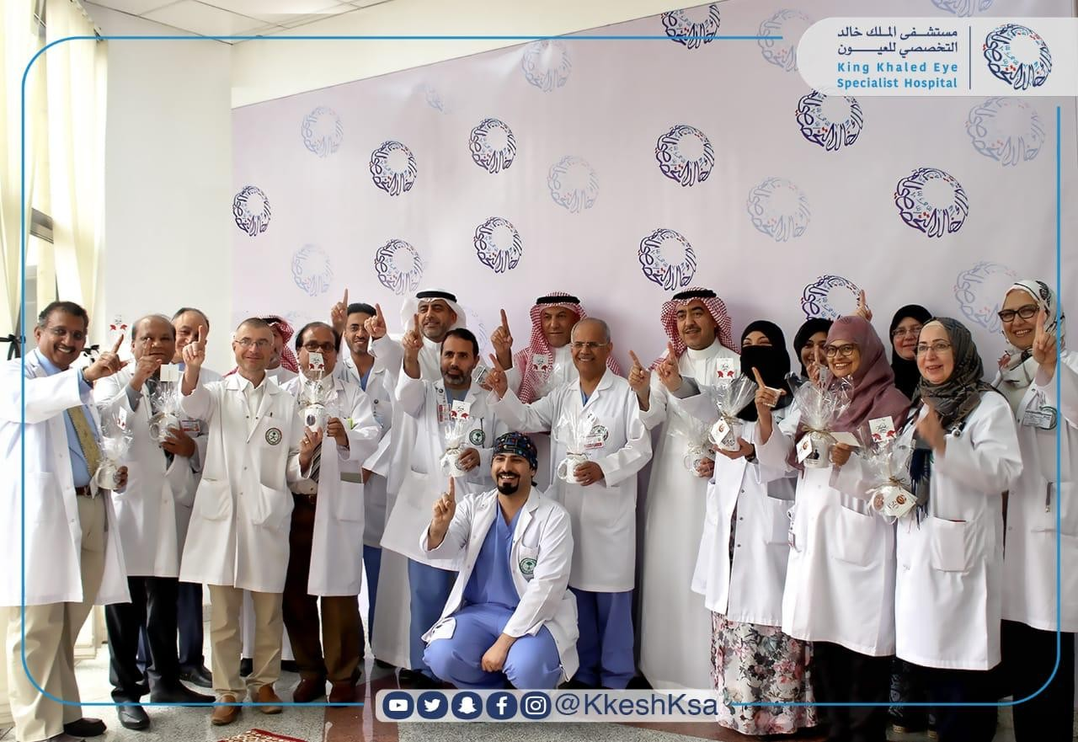

Slide 8
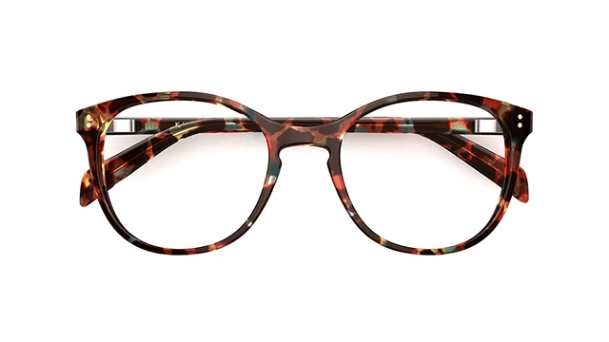
End of the presentation:
Its wonderful thinking about all these jobs and I am sure one day someone will want to become a doctor.
And it’s a great opportunity,
you will get to learn new things.
I have made this presentation so that people can learn more about this amazing role of doctors.
I hope this presentation has encouraged people and want to know more.

